Slide 1
PlantCare AI Sustainable AI Plant Health Assistant

Slide 2
Details
Name : Uzair Javaid Rather
AICTE STUID : STU69f338bd4f21e1777547453
College : Government College of Engineering and Technology, Safapora Ganderbal J&K
Project Title : PlantCare AI - Sustainable AI Plant Health Assistant

Slide 3
Problem Statement
Home gardeners and small-scale growers frequently struggle to keep plants healthy due to limited access to expert agronomic or plant pathology advice. As a result, plant diseases often go undetected until visible damage has already occurred, and watering decisions are typically based on guesswork rather than actual weather or soil conditions. This leads to two avoidable outcomes: unnecessary water consumption from over-watering, and preventable plant loss from late disease diagnosis. With rising concern around sustainable resource use, especially water, there is a clear need for an accessible, low-cost tool that helps everyday plant owners make informed, data-backed care decisions without requiring specialized botanical knowledge or professional consultation.

Slide 4

SDG Alignment
Primary: SDG 12 — Responsible Consumption and Production, addressed through reduced water waste from smarter, data-driven watering decisions.
Secondary: SDG 15 — Life on Land, supported through early plant disease detection and healthier plant outcomes at the individual-grower level.

Slide 5
AI Solution Overview
PlantCare AI lets a user photograph a plant leaf and receive an end-to-end health assessment. A pretrained Hugging Face vision model classifies the leaf as healthy or diseased, while the PlantNet API identifies the plant species — both returning confidence scores rather than blunt yes/no answers. This diagnostic data is combined with live weather (temperature, humidity, rain probability) and passed to a large language model (Groq's Llama 3.3), which generates a plain-language explanation of the plant's condition and answers user follow-up questions conversationally. Separately, a deliberately rule-based (non-AI) engine evaluates weather and plant type to recommend whether watering is needed, prioritizing explainability for this specific decision. Results, watering history, and an aggregated sustainability score (tracking water saved, plants monitored, and diseases caught early) are stored per-user in Supabase with Row Level Security, and visualized on a dashboard. IBM Bob was used during early-stage ideation to help structure the project's architecture and development approach before implementation began.

Slide 6
Target Users
Home gardeners, hobbyist plant owners, and small-scale urban growers who lack easy access to expert plant pathology or agronomic advice. A secondary audience includes students and early-career developers interested in seeing how multiple AI services — computer vision, language generation, and rule-based logic — can be orchestrated together in one practical application.

Slide 7
Responsible AI Considerations
Fairness: The disease detection model is pretrained on a fixed set of crop and disease categories, and may underperform on plant varieties or regional crops not well-represented in its training data. This is a known, stated limitation — confidence scores are always displayed to the user rather than presented as certain fact, so they can calibrate how much to trust each result.
Transparency: Every AI-derived result — species identification, disease detection, and the AI Plant Doctor's explanations — shows its confidence score or reasoning. Watering recommendations are deliberately rule-based rather than AI-generated, specifically so that decision is fully traceable and explainable rather than a black box.
Ethics: The AI Plant Doctor is scoped as general care guidance, not a substitute for professional agronomic or plant pathology consultation, particularly for high-value or commercial crops. No content is generated that could mislead users into unsafe plant treatment decisions.
Privacy: User accounts and all plant, diagnosis, and watering history are protected using Supabase Row Level Security, enforced at the database level — meaning no user can access another user's data even in the event of an application-layer bug. Uploaded images are used only transiently for analysis and are not persisted long-term on the deployed backend.

Slide 8
Expected Impact
By replacing guesswork with real-time, data-backed guidance, users receive immediate feedback on plant health and evidence-based watering recommendations instead of relying on trial and error. This directly reduces unnecessary watering — tracked through the app's estimated-liters-saved metric — and helps catch disease early enough to intervene before significant plant loss.
At an individual level, this means healthier plants and less wasted water for everyday gardeners. At scale, aggregated behavior change across many small growers contributes to more efficient household-level resource use, supporting SDG 12 (Responsible Consumption and Production) through reduced water waste, and SDG 15 (Life on Land) through improved plant health outcomes at the individual-grower level.

Slide 9
Role of ibm bob
IBM Bob was used during the early ideation and planning phase of PlantCare AI, prior to writing any code. It helped structure the project's initial scope — breaking down the broad idea of an "AI plant health assistant" into a concrete feature set (plant identification, disease detection, weather-aware watering, and sustainability tracking) and informing the overall system architecture and development sequence that guided the build. Its role was confined to ideation and planning; the application's runtime AI components (disease classification, species identification, and natural-language explanation) are handled by separate, purpose-built services described in the AI Solution Overview.

Slide 10
Agent logic
While PlantCare AI does not use a dedicated agent framework, its backend orchestration follows agentic principles: given a single input (an uploaded leaf photo), the system autonomously determines which services to call, runs independent ones in parallel, and conditionally chains dependent steps based on the outcome of earlier ones — rather than following one fixed, linear script regardless of context.
Decision logic, step by step:
Parallel dispatch — On receiving an image, the system calls PlantNet (species identification) and the local vision model (disease detection) simultaneously, since neither depends on the other's result.
Conditional escalation — The AI Plant Doctor (LLM explanation) is only invoked once both species and disease results are available — it does not fire on partial or incomplete diagnostic data.
Graceful degradation — If weather data is unavailable (denied location permission, or the weather API failing), the system does not block or fail — it continues the pipeline, and the AI Doctor's prompt is dynamically constructed with or without weather context depending on what's actually present.
State-dependent branching — The watering recommendation engine checks for a saved plant_id before deciding whether to log the interaction to the sustainability tracker, allowing the same endpoint to serve both first-time (unsaved) and returning (saved) usage without duplicating logic.
Independent failure handling — Each external call (PlantNet, weather, LLM) is wrapped in its own error boundary, so one service failing does not cascade into failing the others — the system adapts its response based on which components succeeded.

Slide 11
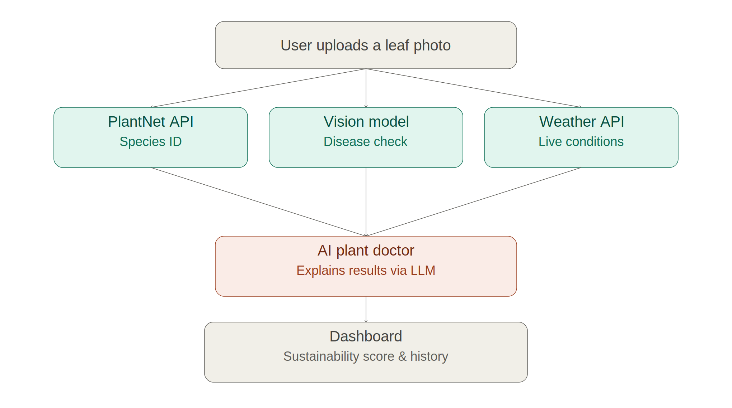
Flow Diagram

Slide 12
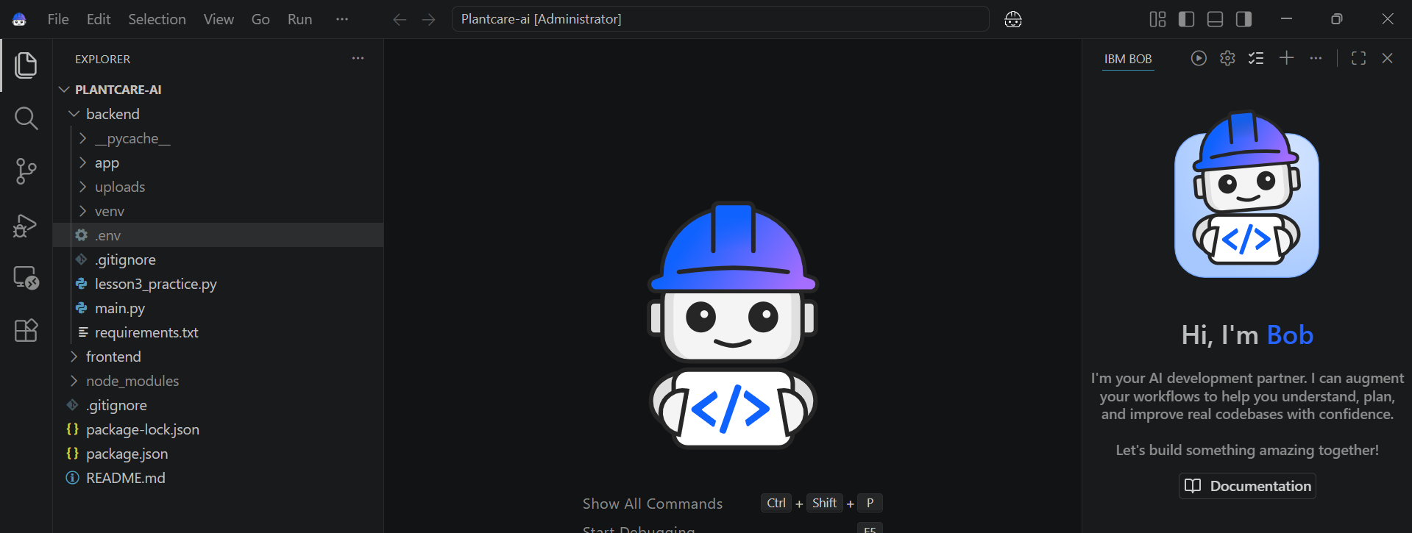
Screenshots

Slide 13
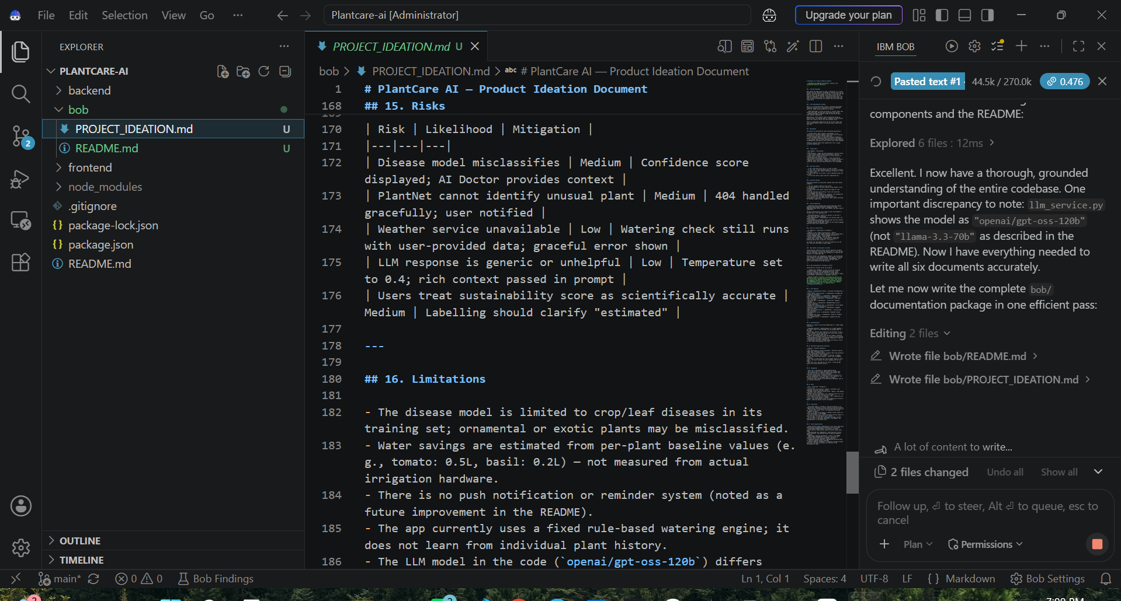
Screenshots

Slide 14
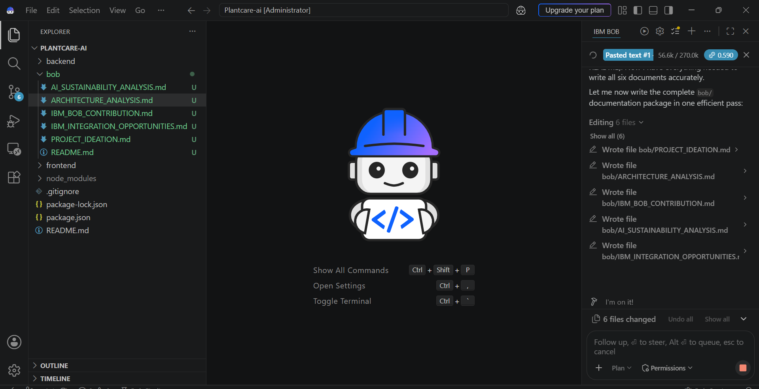
Screenshots

Slide 15
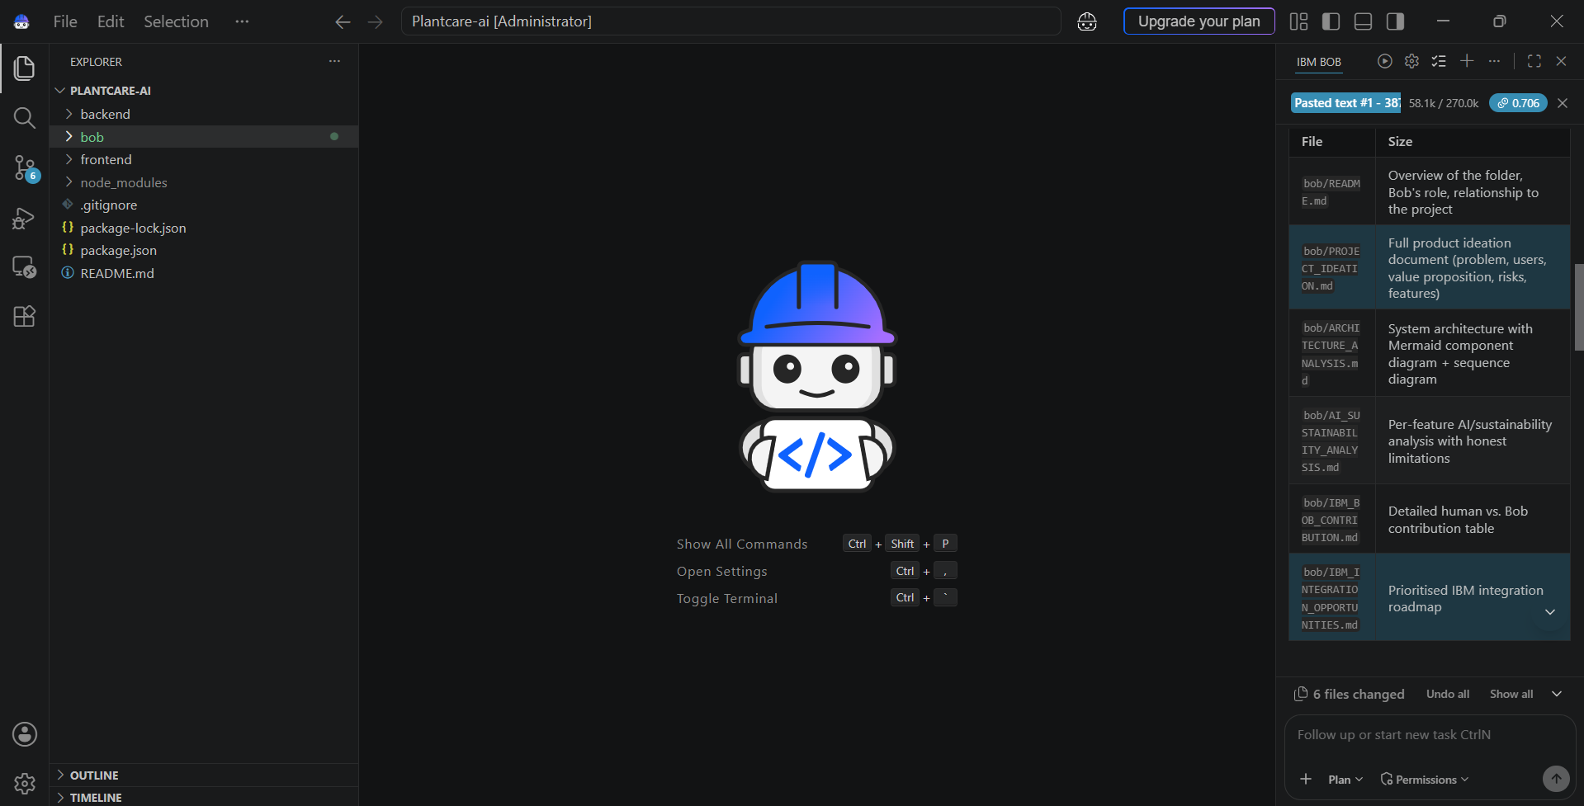
Screenshots

Slide 16
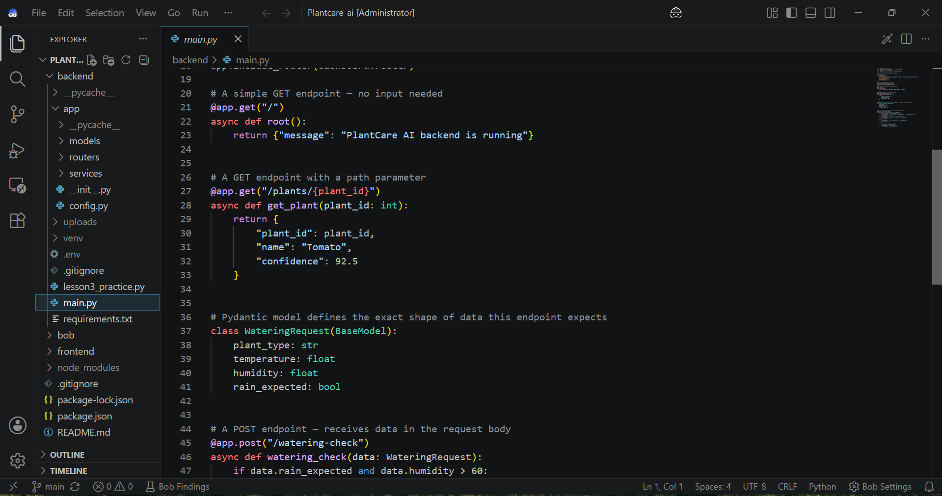
Screenshots

Slide 17
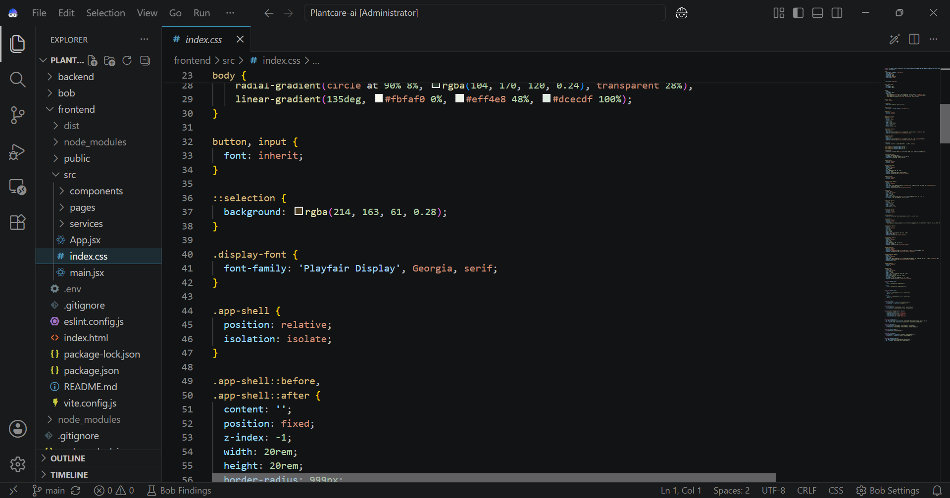
Screenshots

Slide 18
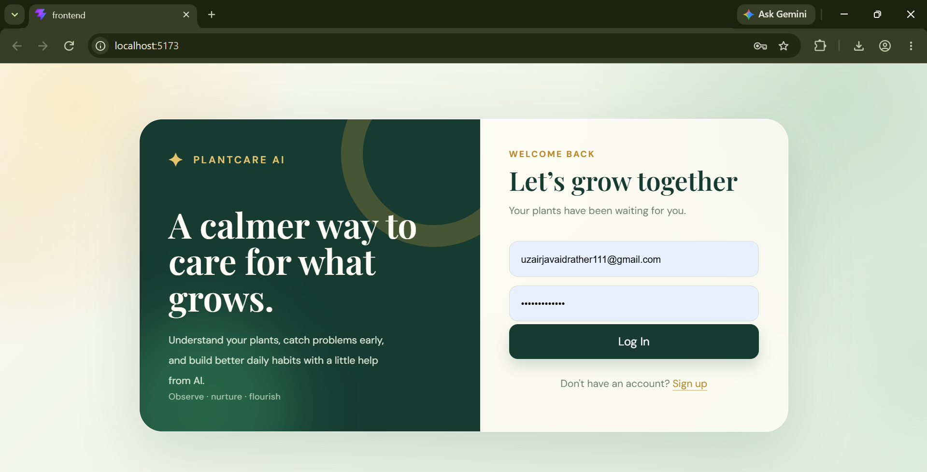
Screenshots

Slide 19
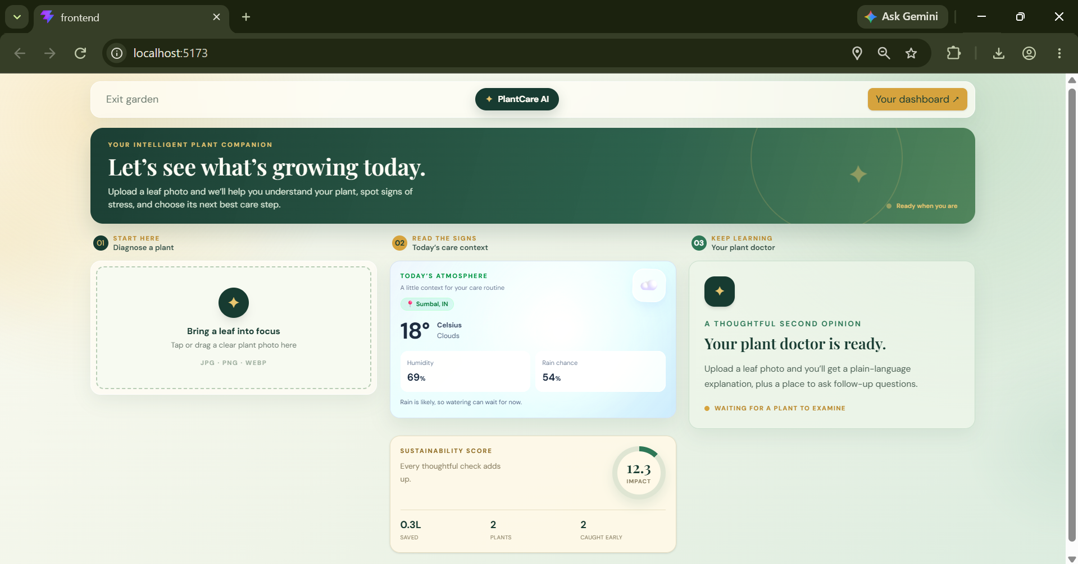
Screenshots

Slide 20
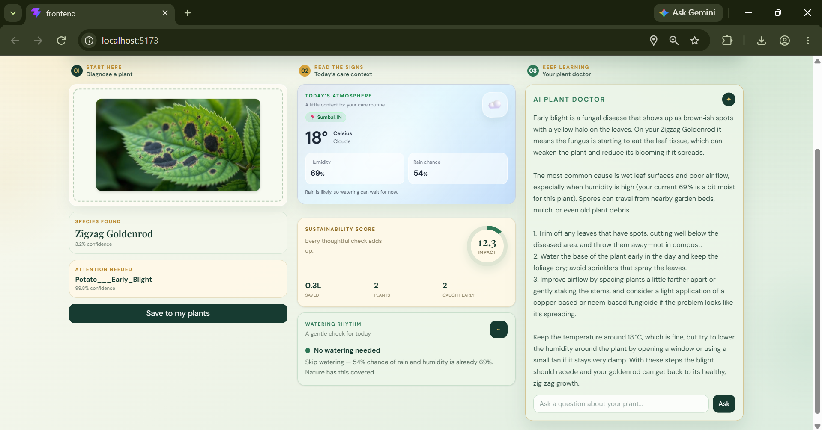
Screenshots

Slide 21
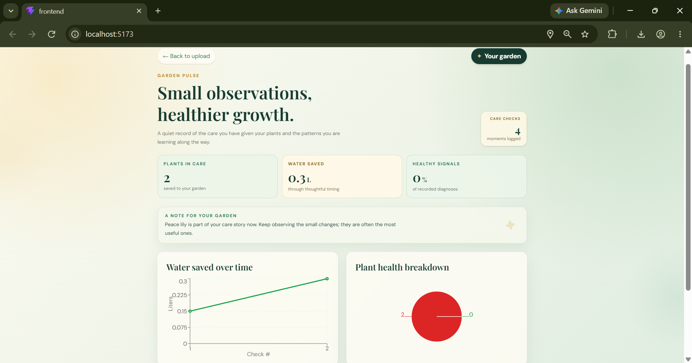
Screenshots

Slide 22
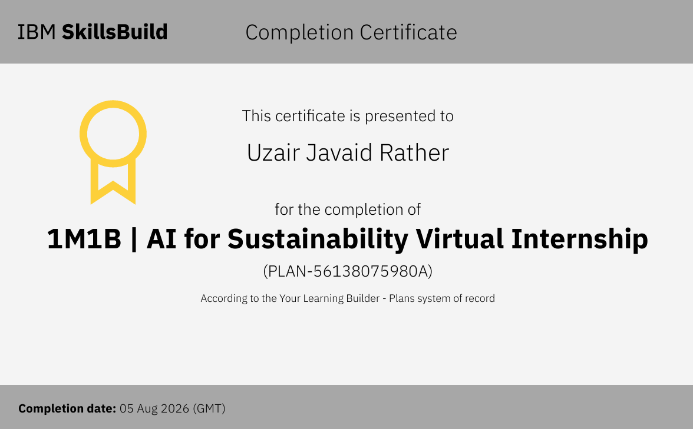
Certificate

Slide 23

Github Link
https://github.com/UzairJavaidRather/PlantCare_AI.git
To Access the Repo : CLICK HERE

Slide 24
Thank you
Uzair Javaid Rather

